Slide 1
Introduction to Docker

Slide 2
Structure
General
Basic Commands
Docker-Compose
Tutorial

Slide 3
General
Open Source
Since 2013
Written in Go
Apache 2.0 Licence

Slide 4
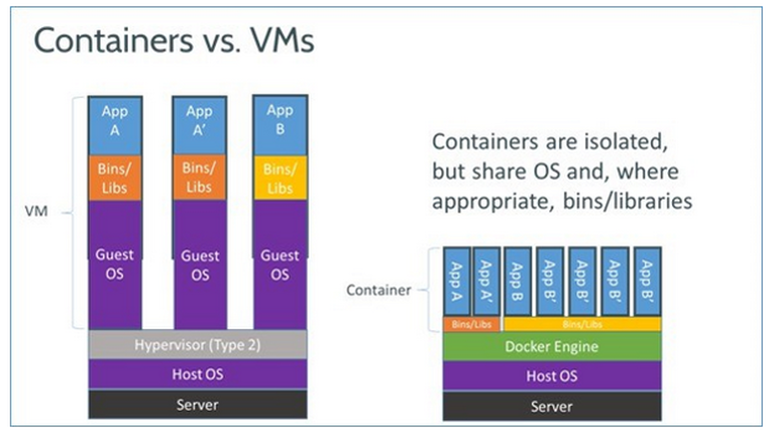
General

Slide 5
General
Docker Hub
All official repositories
place to share own images
Docker Registry
similar to docker Hub but on a private server

Slide 6
General
Docker File
configure your own image
select base image
copy files
create users
set port mappings

Slide 7
Basic Commands
docker run
docker create
docker images
docker kill
docker ps
docker restart
docker rm
docker rmi
docker stop
docker build

Slide 8
Docker-Compose
„Compose is a tool for defining and running multi-container Docker applications.” (Docker Inc., https://docs.docker.com/compose/)
Configuration in .yaml file
run multiple containers with one command
configure port mappings

Slide 9
Tutorial
Basic functions of docker and docker-compose

